Slide 1
Understanding Employee Attrition
HR Analytics on the IBM HR Dataset
Lianny Prosetijo Satyawan | SCTP Associate Data Analyst capstone
Notes:
Objective: identify the key factors driving attrition and give HR leaders data-backed retention and workforce planning recommendations.

Slide 2
Project objective and problem statement
Project objective
Analyse the IBM HR Analytics dataset to identify the key factors driving employee attrition, and give HR leaders data-backed recommendations for improving retention and workforce planning.
Problem statement
Attrition creates high costs, disrupts productivity and erodes institutional knowledge. Organisations struggle to turn demographic, compensation and performance data into targeted retention strategies.
Which factors most influence attrition, and which groups are at highest risk?

Slide 3
Research objectives
Profile the workforce and attrition by department, job role, age, gender and tenure
1
Examine attrition against compensation and career progression
2
Assess the effect of overtime, business travel and distance from home
3
Evaluate links with engagement: satisfaction, work-life balance and job involvement
4
Compare performance ratings with attrition to see whether high performers are leaving
5

Slide 4
Data cleaning and preparation (Power Query)
Load and select
1,470 rows; only the columns the objectives need; constant and ID columns removed
1
Clean values
2
5 missing ages filled with the median (36); Gender spaces trimmed and typos fixed (Femal, m, M)
Flags and ranges
Attrition flag (1 left, 0 stayed); ranges for age, tenure, income, distance, salary hike, promotion and manager
3
Label coded fields
4
Scores 1 to 4 turned into labels such as Low and Very High; original numbers kept for sorting
Measures and checks
5
Headcount, Leavers and Attrition Rate measures; totals reconcile at 1,470 employees and 237 leavers
Prepared once in Power Query so every chart and measure uses the same definitions.

Slide 5
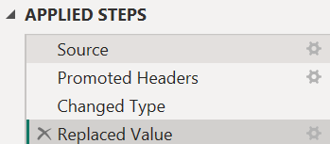
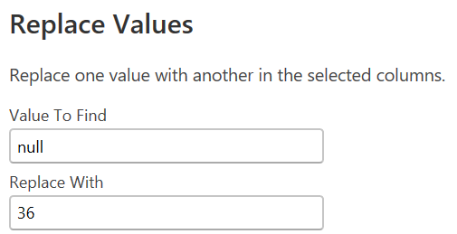
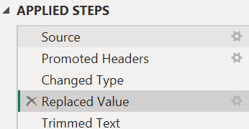
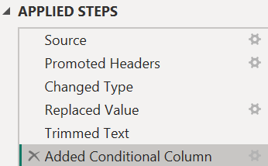
Data cleaning: screenshots
Age: 5 null values replaced with median (36)
Gender: Trim removes leading and trailing spaces
Gender: conditional column fixes "Femal", "m", "M"

Slide 6
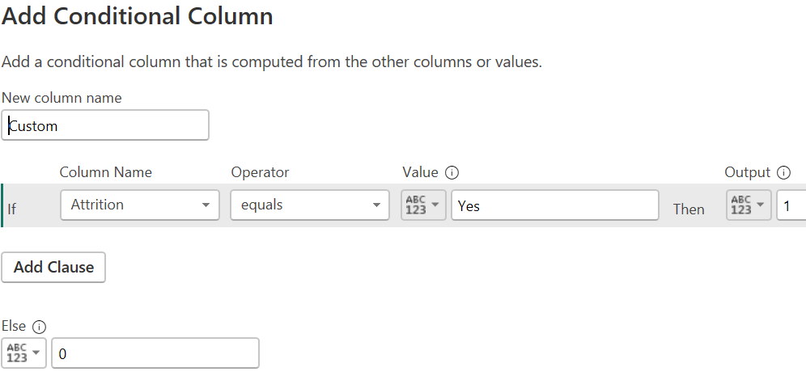
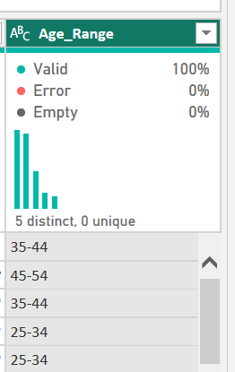
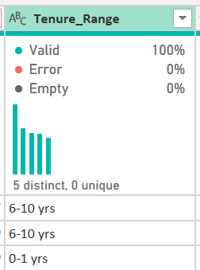
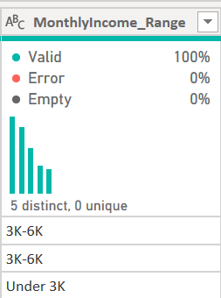
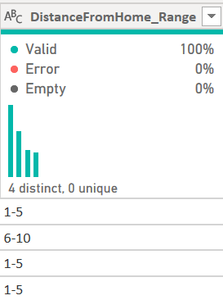
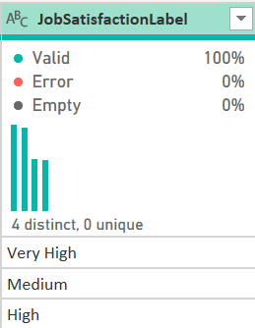
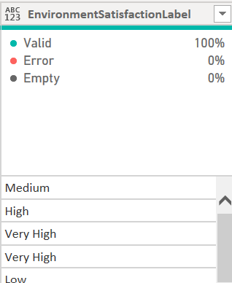
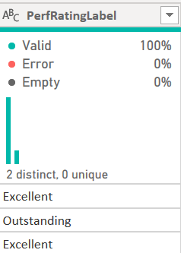



Data preparation: screenshots
AttritionFlag (1 = left, 0 = stayed)
Bands / Ranges: age, tenure, income, distance
Label columns for coded fields
Measures: Headcount, Leavers, Attrition Rate

Slide 7
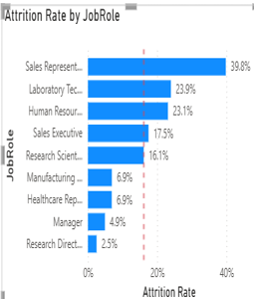
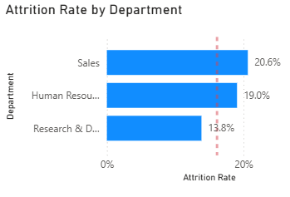
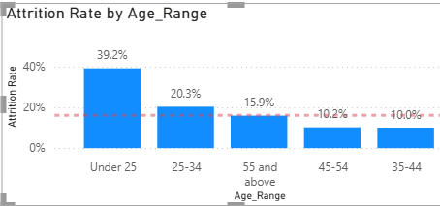
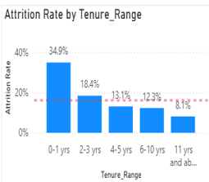
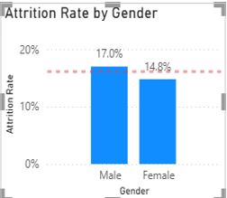
1. Workforce profile: 1 in 6 employees left
1,470 employees
237 left
16.1% attrition rate
A
B
C
D
E
Each rate is compared with the 16.1% company rate (dotted line). Findings for charts A to E are on the next slide.

Slide 8
Workforce profile: key findings
Chart A
Chart A
Chart C
39.8%
2.5%
39.2%
Sales Representatives
Research Directors
Under 25s
Highest-risk role; Sales dept 20.6%
Falls with seniority; Managers 4.9%
2.4x the company rate
Chart D
Chart E
34.9%
17.0% vs 14.8%
First-year employees
Male vs female
8.1% after 11+ years
Gender is not a driver
Junior sales, young and new employees drive attrition. Small groups (e.g. HR) need caution.

Slide 9
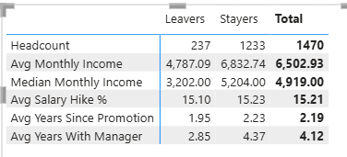
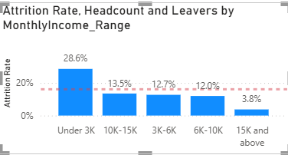
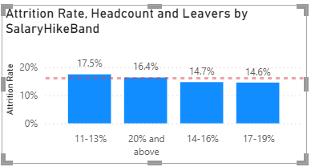
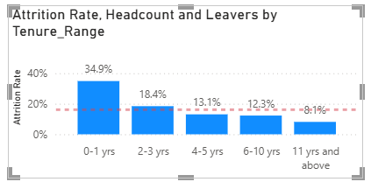
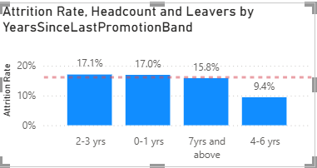
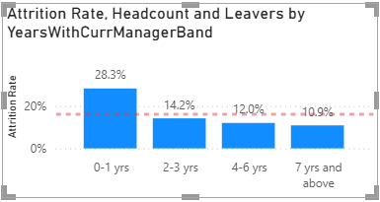
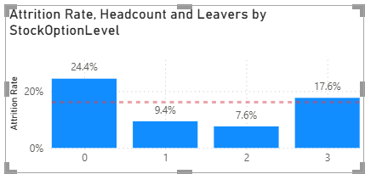
2. Compensation and career progression
A
B
C
D
E
F
Each rate is compared with the 16.1% company rate (dotted line). Findings for charts A to F are on the next slide.

Slide 10
Compensation and career: key findings
Chart A
Chart B
Chart C
28.6%
14.6% to 17.5%
34.9%
Under 3K earners
Salary increase bands
First-year employees
Leavers earn 38% less (median)
Pay rise size makes little difference
8.1% at 11+ years
Chart D
Chart E
Chart F
9.4% to 17.1%
28.3%
24.4%
Years since promotion
First year with manager
No stock options
No clear pattern
10.9% at 7+ years
Levels 1 and 2: 7.6% to 9.4%
Low pay and short tenure drive attrition; pay rises and promotion timing do not.

Slide 11
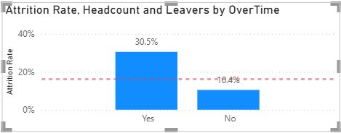
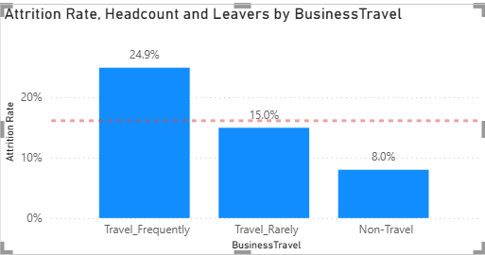
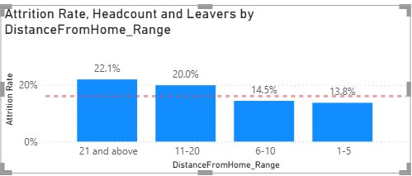
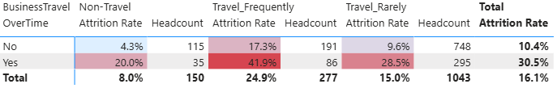
3. Work conditions: overtime, travel and distance
A
B
C
D
Each rate is compared with the 16.1% company rate (dotted line). Findings for A to D are on the next slide.

Slide 12
Work conditions: key findings
Chart A
Chart B
30.5%
24.9%
Overtime
Frequent travel
vs 10.4% without: nearly 3x
vs 16.1% company average
Chart C
Chart D
22.1%
41.9%
Longest distance
Overtime + frequent travel
Attrition rises with distance
Highest-risk mix
Overtime is the biggest work-condition driver; combined with travel, risk peaks.

Slide 13
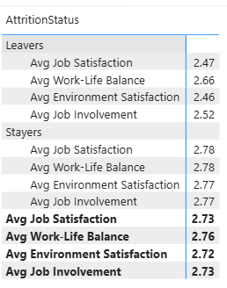
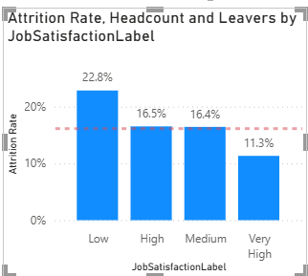
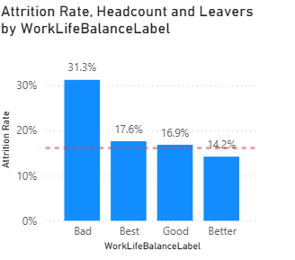
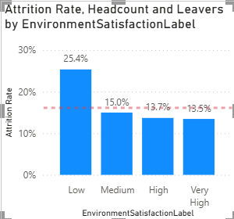
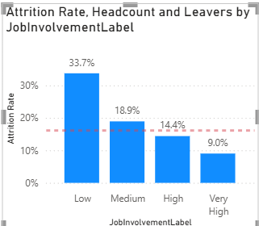
4. Engagement indicators
E
A
B
C
D
Each rate is compared with the 16.1% company rate (dotted line). Findings for A to E are on the next slide.

Slide 14
Engagement: key findings
Chart A
Chart B
Chart C
22.8%
31.3%
25.4%
Low job satisfaction
Poor work-life balance
Low environment satisfaction
Very high: 11.3%
Almost double the average
Raises risk
Chart D
Chart E
33.7%
0.12 to 0.31
Low job involvement
Score gap, leavers vs stayers
Highest of the four
Leavers score lower on all four
The least engaged leave most. These groups can be small.

Slide 15
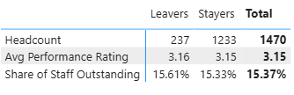
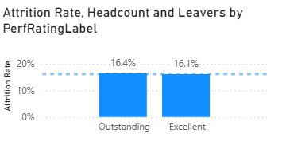
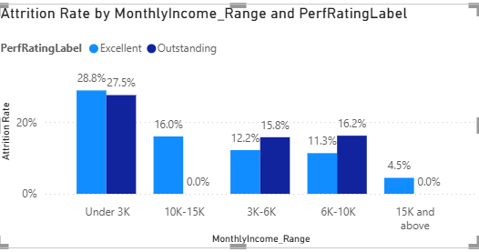
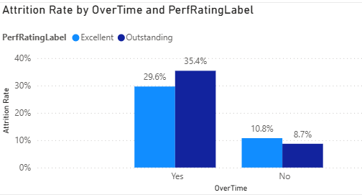
5. Performance ratings and attrition
A
B
C
D
Each rate is compared with the 16.1% company rate (dotted line). Findings for A to D are on the next slide.

Slide 16
Performance: key findings
Chart A
Chart B
3.16 vs 3.15
16.4% vs 16.1%
Average rating
Outstanding vs Excellent
Leavers and stayers rate alike
Top performers not leaving more
Chart C
Chart D
About 28%
35.4%
Under 3K earners
Outstanding on overtime
Whatever the rating
8.7% without overtime
Not a performance problem: pay, overtime and engagement drive attrition.

Slide 17
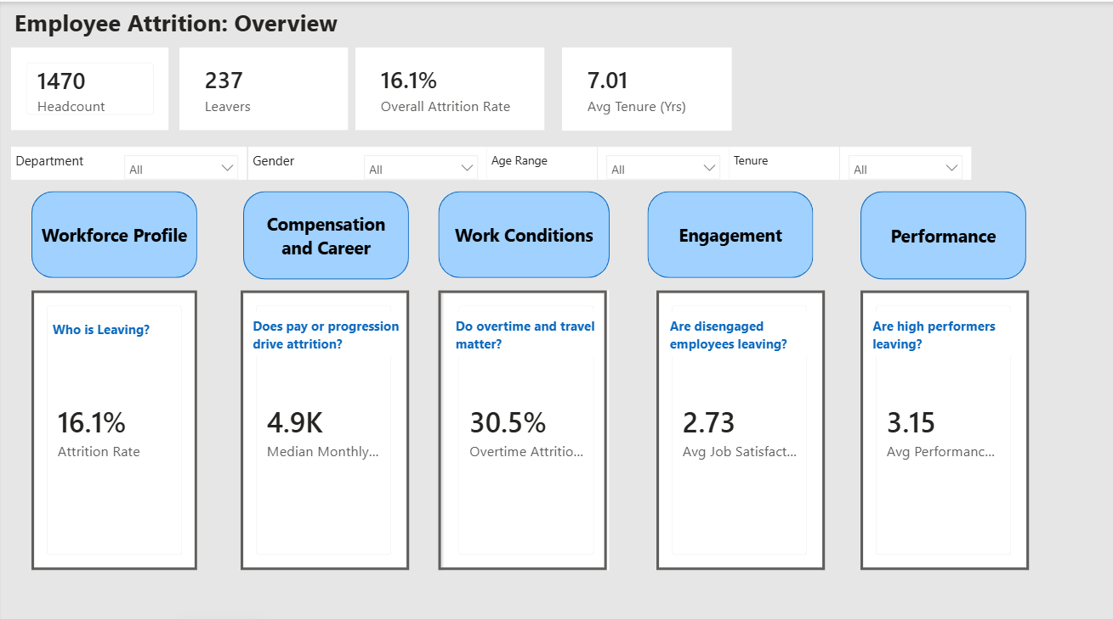
Interactive Power BI dashboard
One home page
The Overview page shows the headline numbers and a tile for each of the five objectives.
Click to explore
Each tile opens its page. A Home button returns to the overview.
Filter everything
Department, gender and age range slicers filter every page.
HR leaders can explore every finding in this deck interactively.

Slide 18
Key drivers and high-risk segments
Strongest drivers (gap between highest and lowest group, points)
High-risk segments (company rate 16.1%)
41.9%
39.8%
Overtime + frequent travel
Sales Representatives
39.2%
35.4%
Under 25s
Outstanding on overtime
34.9%
33.7%
First-year employees
Low job involvement
28.6%
Segments overlap; some groups are small
Income under 3K
Role, age, tenure, pay, job involvement and overtime drive attrition; ratings and gender do not.

Slide 19
Recommendations linked to the findings
Manage overtime
Support travellers and commuters
Review pay and rewards
30.5% vs 10.4%
24.9% vs 8.0%
28.6% under 3K
Review workloads, starting with travel-heavy roles
Rotation, recovery time, flexible work
Review entry-level pay and stock options
Strengthen the first year
Act on engagement signals
Plan the workforce
34.9% first year
33.7% low involvement
39.8% Sales Reps
Better onboarding and manager support
Track scores; follow up on low ones
Plan hiring and succession for high-turnover roles
Highest risk: junior sales, under 25s, new joiners, low earners. Drivers: role, age, tenure, pay, involvement, overtime.
Association, not causation. Fictional, imbalanced dataset (237 leavers) with no cost data.

Slide 20
Thank you
Any questions?
Lianny Prosetijo Satyawan | Understanding Employee Attrition

